Slide 1
Asset Management Transaction Reversal
Ashley Carbone, GeorgiaFIRST
May 24, 2017

Slide 2
Agenda
WebEx Housekeeping
Transaction Reversal Overview
Reversal Reason Codes
Transaction Reversal Walkthrough
Incorrect Cost Adjustment
Reversal for initial asset addition

Slide 3
WebEx Housekeeping
Please stay muted throughout the presentation.
There will be points during the presentation for questions.
“Raise Hands” for questions and comments.
Chat VS Q&A
Chat should be used for discussion.
Use Q&A for specific questions.

Slide 4
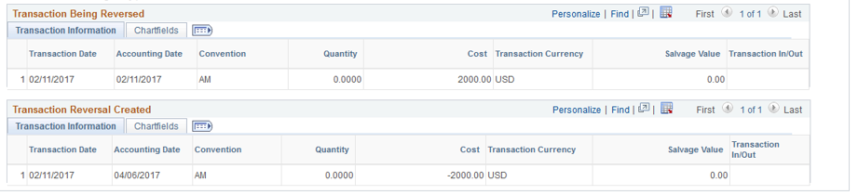
Transaction Reversal Overview
What does it do?
Transaction Reversal automatically reverse the transaction last performed on the asset.
Used after depreciation calculation (Depr Calc).

Slide 5
Transaction Reversal Overview
Rules for Transaction Reversal
Can only be performed on assets that have been run through Depr Calc.
Can be completed on initial asset additions, subsequent asset cost additions, adjustments, chartfield transfers, and recategorizations.
Must be performed before entries are posted to General Ledger.
Cannot be performed on non-financial (SVP) assets.
Assets retired incorrectly must be reinstated.

Slide 6
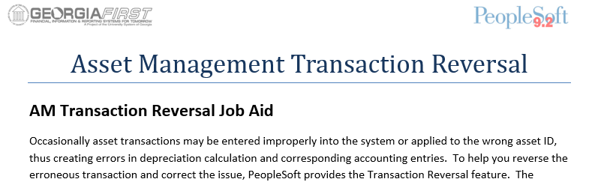
Transaction Reversal Overview
Link to Transaction Reversal Job Aid
http://www.usg.edu/gafirst-fin/documentation/job_aids/category/asset_management

Slide 7
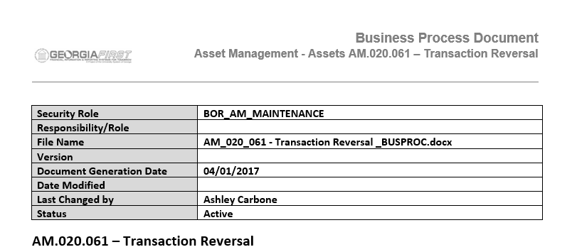
Transaction Reversal Overview
Link to Transaction Reversal Business Process
http://www.usg.edu/gafirst-fin/documentation/category/asset_management

Slide 8
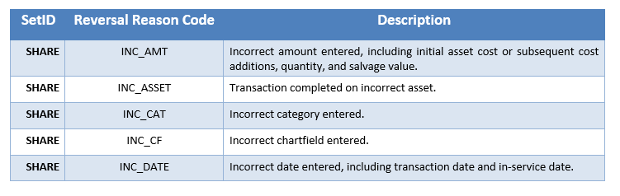
Reversal Reason Codes
All Transaction Reversals should be associated with a reversal reason code
Additional codes can be added, however it will be across all institutions.

Slide 9
Transaction Reversal Walkthrough
Incorrect Cost Adjustment

Slide 10
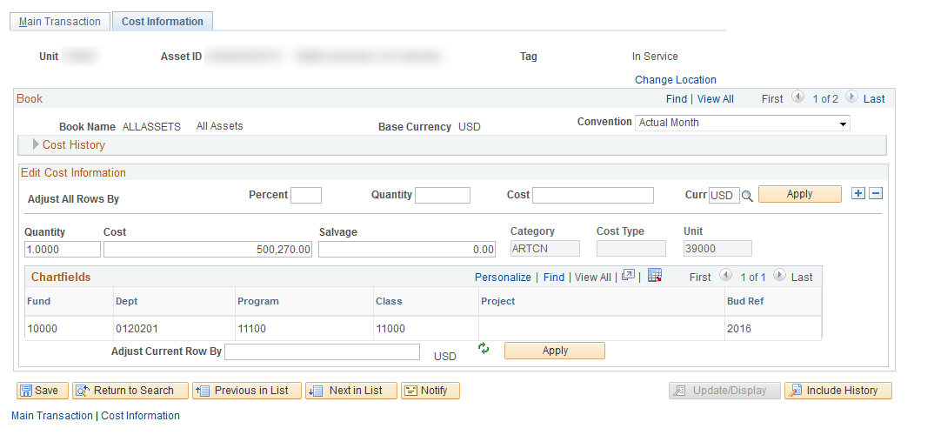
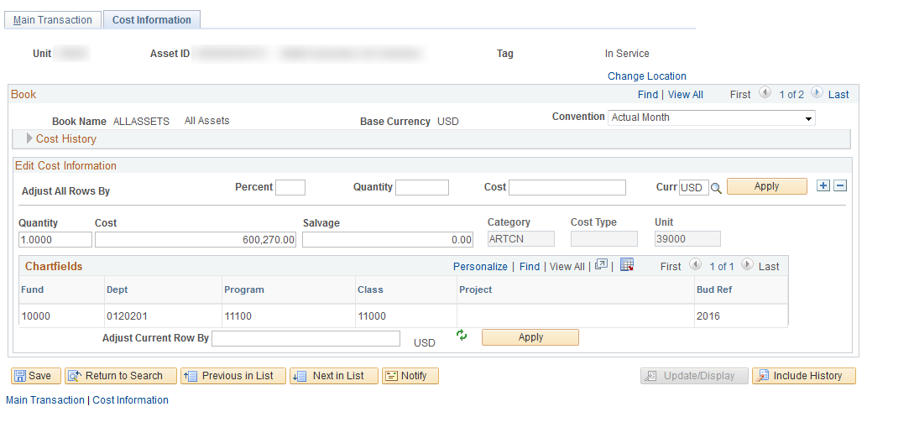
Transaction Reversal Walkthrough
Incorrect Cost Adjustment
Increased cost by $100,000

Slide 11
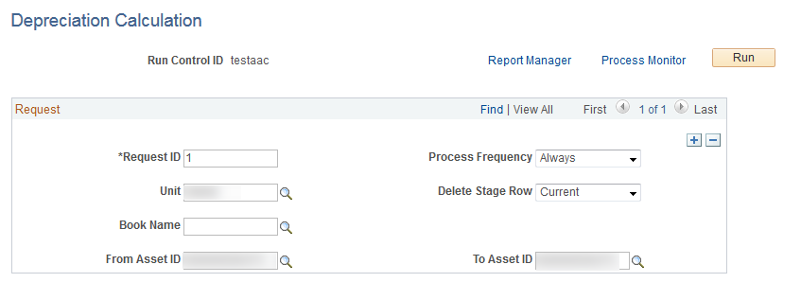
Transaction Reversal Walkthrough
Incorrect Cost Adjustment
Run Depr Calc

Slide 12
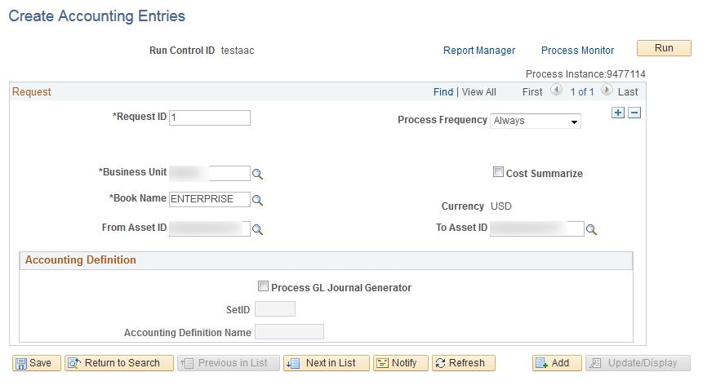
Transaction Reversal Walkthrough
Incorrect Cost Adjustment
Run Create Accounting Entries (optional)
* If completed, allows use of Review Financial Entries search to confirm transaction details.

Slide 13
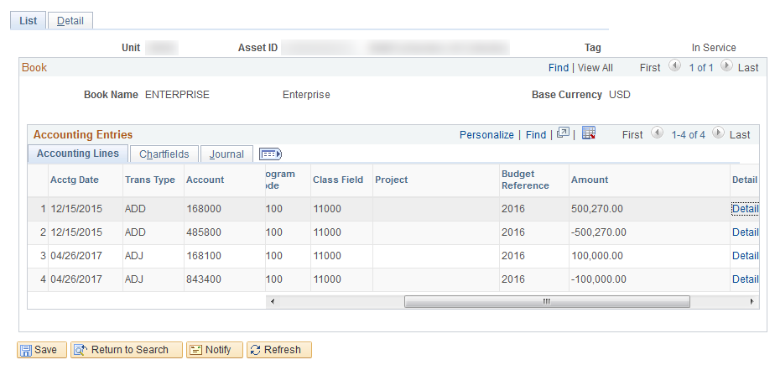
Transaction Reversal Walkthrough
Incorrect Cost Adjustment
Review Financial Entries

Slide 14
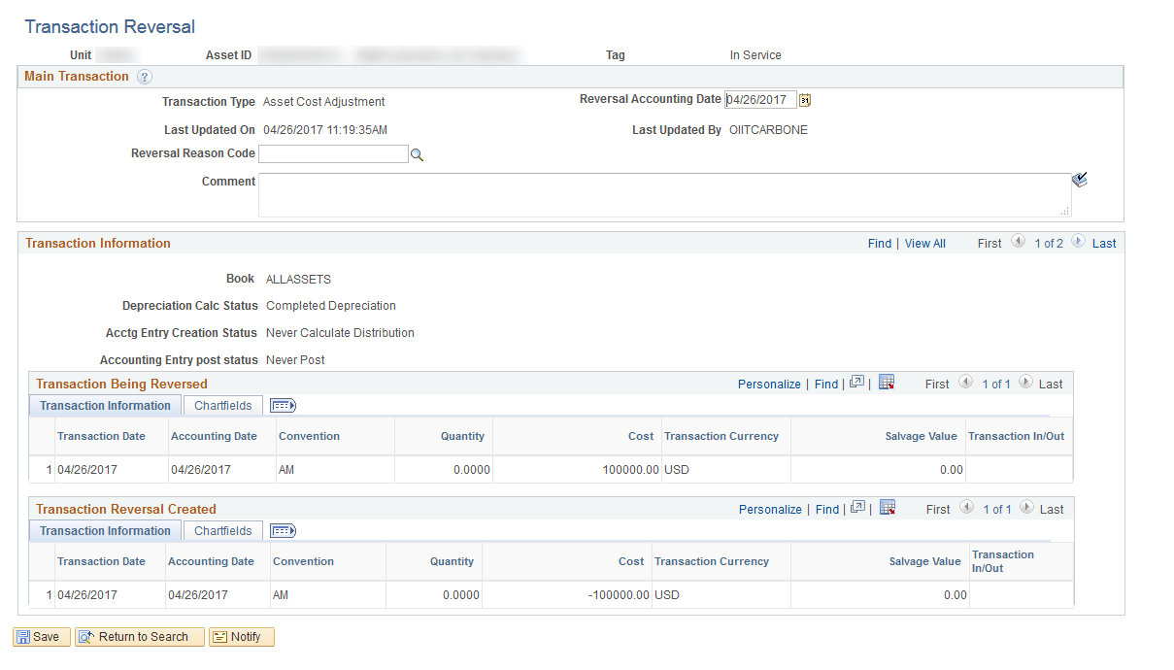
Transaction Reversal Walkthrough
Incorrect Cost Adjustment
Transaction Reversal

Slide 15
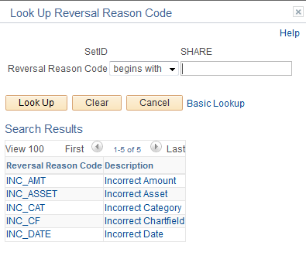
Transaction Reversal Walkthrough
Incorrect Cost Adjustment
Transaction Reversal Reason Code Selection
SetID will always be SHARE

Slide 16
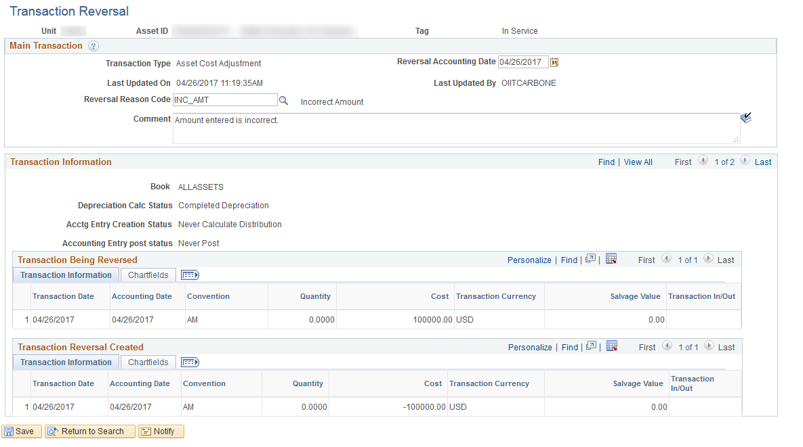
Transaction Reversal Walkthrough
Incorrect Cost Adjustment
Transaction Reversal Reason Selected

Slide 17
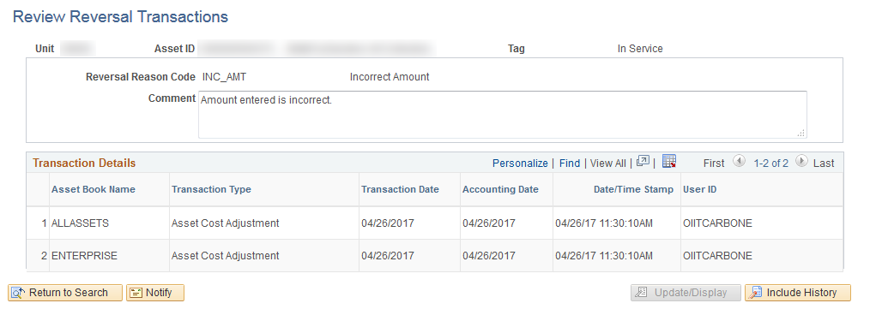
Transaction Reversal Walkthrough
Incorrect Cost Adjustment
Review Transaction Reversal

Slide 18
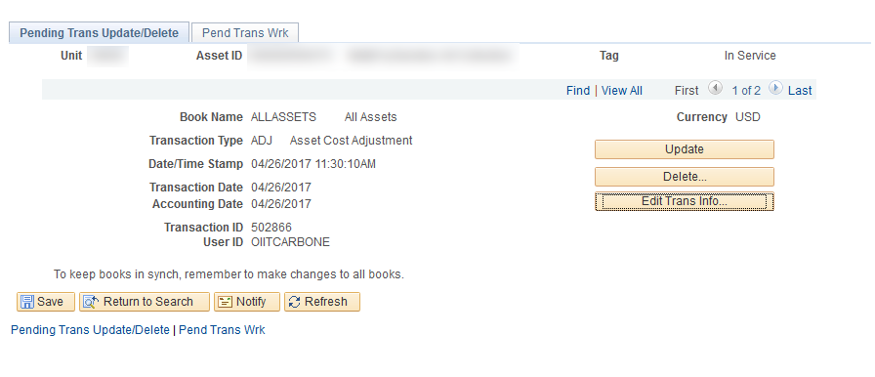
Transaction Reversal Walkthrough
Incorrect Cost Adjustment
Use Update/Delete Pending Trans Pages to correct asset transaction in needed.
Use Update to update Cost or Quantity.
Use Delete to delete entire transaction
Use Edit Trans Info to update Transaction Date and or Accounting Date

Slide 19
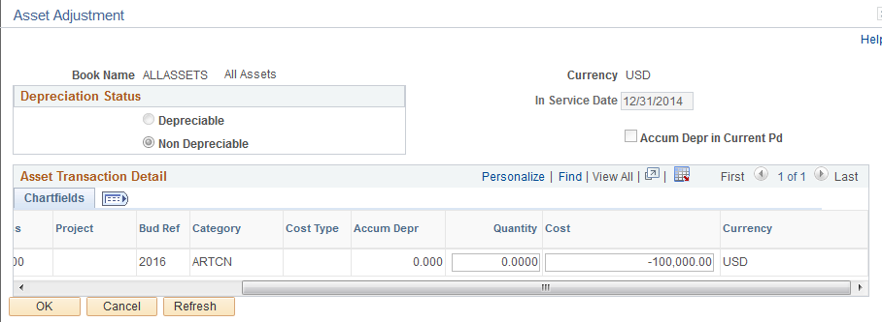
Transaction Reversal Walkthrough
Incorrect Cost Adjustment
After choosing the Update button, I can see the transaction is for the reversal of the cost adjustment.
If this is correct, we can run Depr Calc and Create Accounting Entries again.
If the transaction reversal is incorrect or is not needed anymore, we can use the Delete button on the previous page to delete the pending transaction reversal.

Slide 20
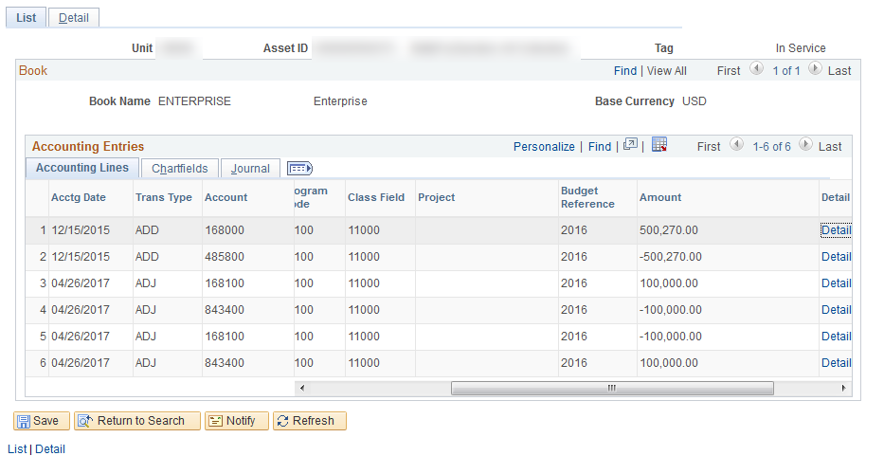
Transaction Reversal Walkthrough
Incorrect Cost Adjustment
Ran Depr Calc and Create Accounting Entries, so that I can use Review Financial Entries.

Slide 21
Transaction Reversal Walkthrough
Process will work the same for any adjustment reversals.
Only difference will be which Reversal Reason Code is chosen.
Reversing initial asset adds is slightly different.

Slide 22
Transaction Reversal Walkthrough
Reversing initial asset addition

Slide 23
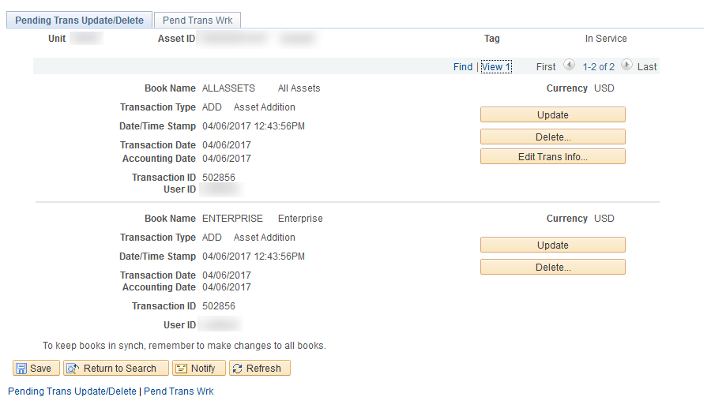
Transaction Reversal Walkthrough
Initial Asset Add Reversal
If Depr Calc has not been run, use Change/Delete Pending Trans (Delete option) to reverse the adding of the asset.

Slide 24
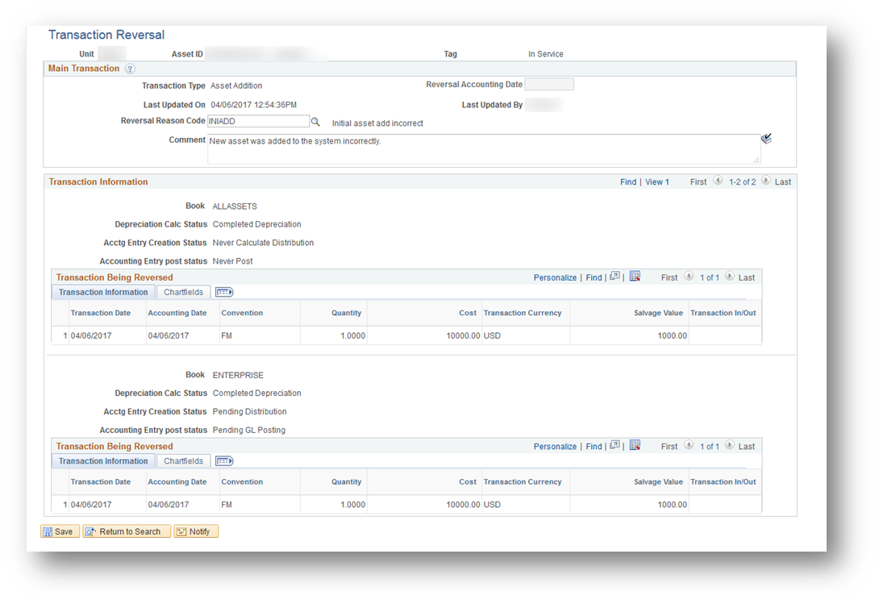
Transaction Reversal Walkthrough
Initial Asset Add Reversal
If Depr Calc has already been ran, use Transaction Reversal then the Change/Delete Pending Trans (Delete option) to reverse the adding of the asset.

Slide 25
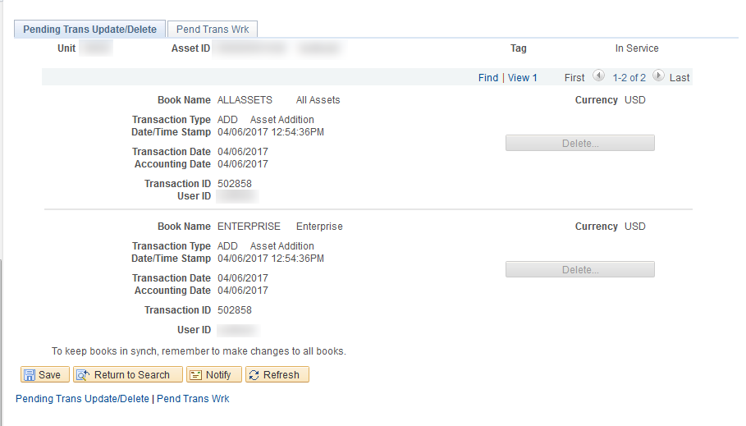
Transaction Reversal Walkthrough
Initial Asset Add Reversal
When Delete option is used, asset will be removed from the system and the next asset add will use next asset ID.
Example: Asset ID 501038 was deleted, so our next asset ID will be 501039.

Slide 26
Questions?

Slide 27

University System of Georgia
Information Technology Services

